Slide 1
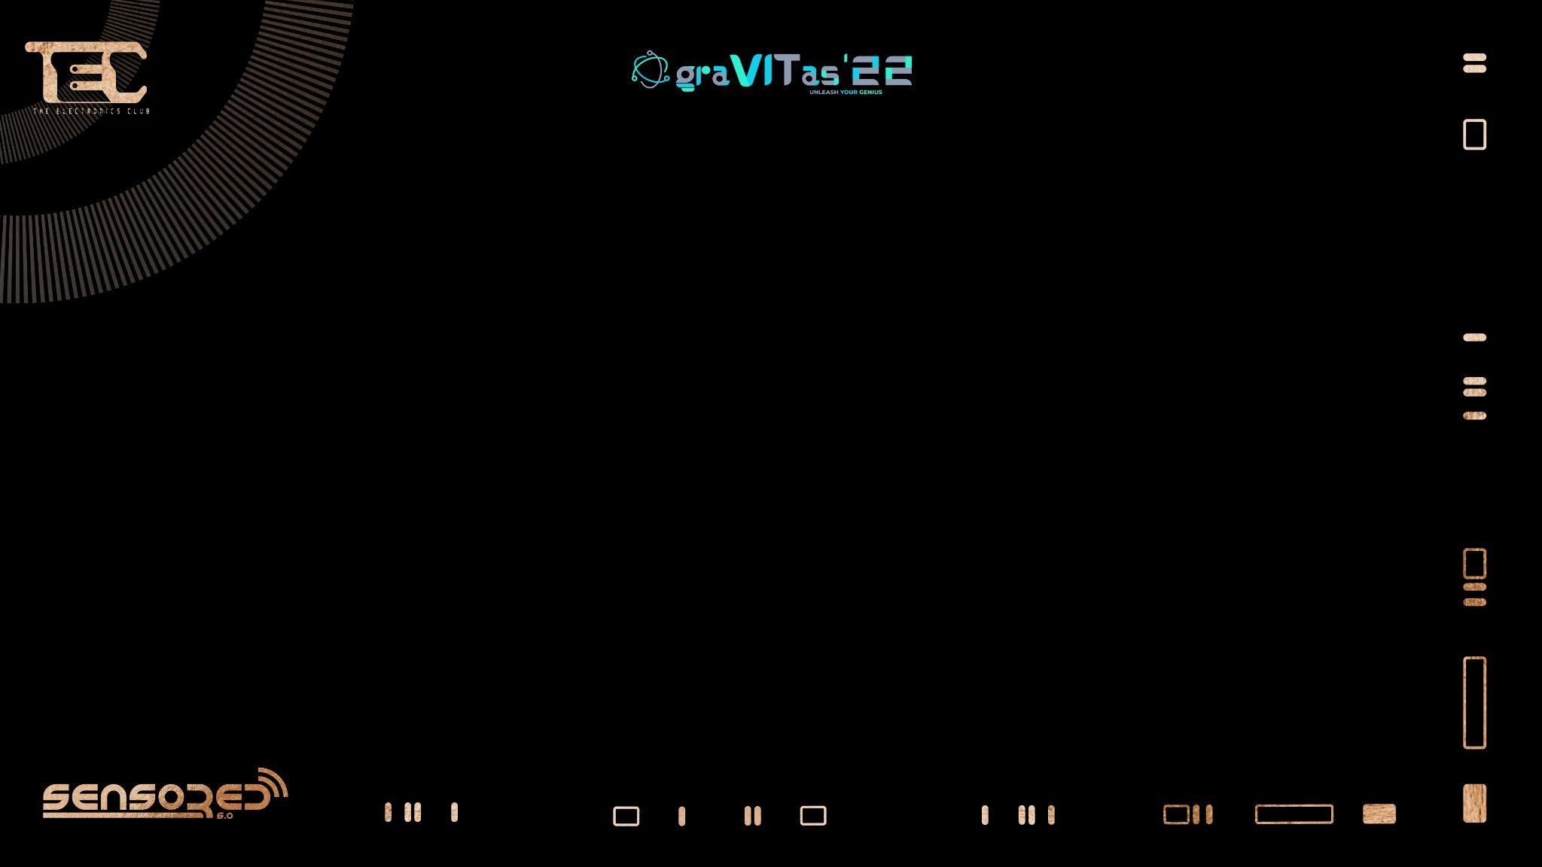

HC-05

Slide 2

Who we are.

Slide 3
But what is Bluetooth?
Bluetooth is a technology that aims to achieve three objectives:
To eliminate wires associated with most consumer and computer equipment, without user intervention.
To allow multiple devices to be connected at the same time and facilitate communication between all of them.
Make a location centric connectivity seamless (devices automatically find each other and discover what they can do for each other).
Notes:
Hc05 interface between devices/modules, replacing wires (not magic).
Master – initiate connections and scan for devices to connect to
Slave – receives and waits for connections

Slide 4
More about Bluetooth
Bluetooth is a dynamic open standard for exchanging data wirelessly over short distances from fixed and mobile devices to create personal area networks (PANs) with high levels of security.
It allows connectivity utilizing RF (radio frequency) technology in the unlicensed ultra high frequency 2.4 GHz (2400-2483.5 MHz) ISM (Industry, Scientific, Medical) band.
Unlike infrared, which uses a beam of light to transmit data and is found in many remote controls, wireless keyboards, etc., Bluetooth uses radio frequency to communicate.
Notes:
Hc05 interface between devices/modules, replacing wires (not magic).
Master – initiate connections and scan for devices to connect to
Slave – receives and waits for connections

Slide 5
How it Works
As with any digital system, Bluetooth works by sending and receiving a stream of 1s and 0s.
1 is represented by a RF wave of a particular frequency, 0 is represented by a wave of another frequency.
The waves are emitted by the transmitters omnidirectionally, therefore allowing a transmitter-receiver system to work in any spatial orientation within range.
Each stream or group of 1s and 0s is called a packet and forms the basic unit of communication with Bluetooth.
Each packet begins with an Access Code of one of 3 types: Channel Access Code, Device Access Code and Inquiry Access Code; followed by the Packet Header and Payload.
CAC identifies a network of BT devices, DAC is used for special signaling procedures and IAC to discover other BT units in range.
Notes:
Hc05 interface between devices/modules, replacing wires (not magic).
Master – initiate connections and scan for devices to connect to
Slave – receives and waits for connections

Slide 6
Applications of Bluetooth
Laptops
Mobile Phones
Wireless Headsets
PDA
To Transfer data files
(Personal Digital Assistants)

Slide 7
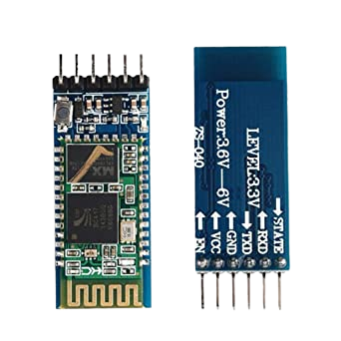

What is HC-05?
Basically HC-05 is the Bluetooth module, Designed to replace cable connections (Super Cool).
Notes:
UART Communication Protocol

Slide 8


What does HC-05 do?
HC-05 uses serial communication to communicate with the electronics. Usually, it is used to connect small devices like mobile phones using a short-range wireless connection to exchange files. As discussed, it uses the 2.45GHz frequency band.

Slide 9
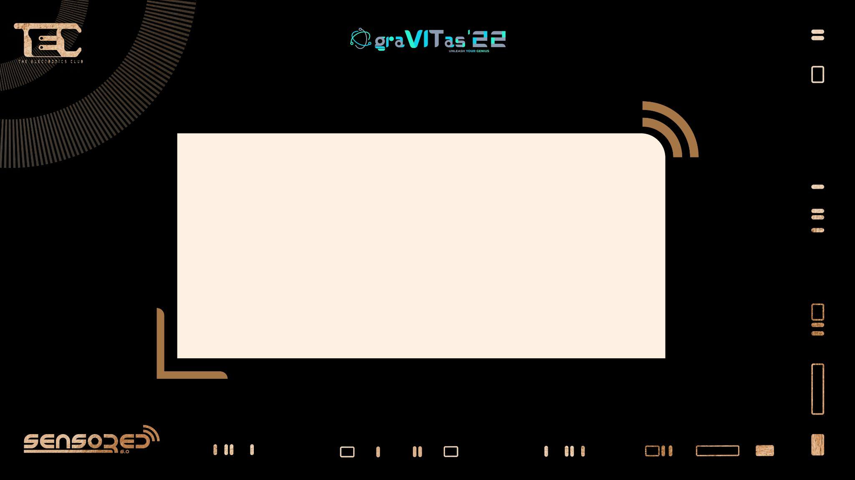
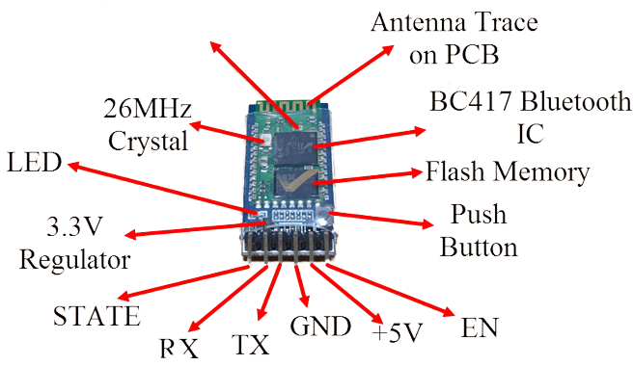

What does HC-05 consist of?
RF Transformer
Notes:
An RF transformer is an electromagnetic device that sits between two or more circuits and uses changes of electric signals and the principle of induction in a conductor to produce a varying magnetic field (flux) that couples energy through to another conductor.

Slide 10

Pins:
Enable - This pin is used to set the Data Mode or and AT command mode (set high).
VCC - This is connected to +5V power supply.
Ground - Connected to ground of powering system.
Tx (Transmitter) - This pin transmits the received data Serially.
Rx (Receiver) - Used for broadcasting data serially over bluetooth.
State -Used to check if the bluetooth is working properly.
Notes:
Enable - This pin is used to set the Data Mode or and AT command mode (set high).
VCC - This is connected to +5V power supply.
Ground - Connected to ground of powering system.
Tx (Transmitter) - This pin transmits the received data Serially.
Rx (Receiver) - Used for broadcasting data serially over bluetooth.
State -Used to check if the bluetooth is working properly.

Slide 11
Modes Of Operation
Command Mode
Data Mode

Slide 12
Command Mode
In Command Mode, you can communicate with the Bluetooth module through AT Commands for configuring various settings and parameters of the Module like get the firmware information, changing Baud Rate, changing module name, it can be used to set it as master or slave.
A point about HC-05 Module is that it can be configured as Master or Slave in a communication pair. In order to select either of the modes, you need to activate the Command Mode and sent appropriate AT Commands.
Notes:
Hc05 interface between devices/modules, replacing wires (not magic).
Master – initiate connections and scan for devices to connect to
Slave – receives and waits for connections

Slide 13
Data Mode
Coming to the Data Mode, in this mode, the module is used for communicating with other Bluetooth device i.e. data transfer happens in this mode.

Slide 14

Hands on Time!

Slide 15

Code
#include<SoftwareSerial.h>
/* Create object named bt of the class SoftwareSerial */
SoftwareSerial bt(2,3); /* (Rx,Tx) */
void setup() {
bt.begin(9600); /* Define baud rate for software serial communication */
Serial.begin(9600); /* Define baud rate for serial communication */
}
void loop() {
if (bt.available()){ /* If data is available on serial port */
Serial.write(bt.read()); /* Print character received on to the serial monitor */
}
}

Slide 16
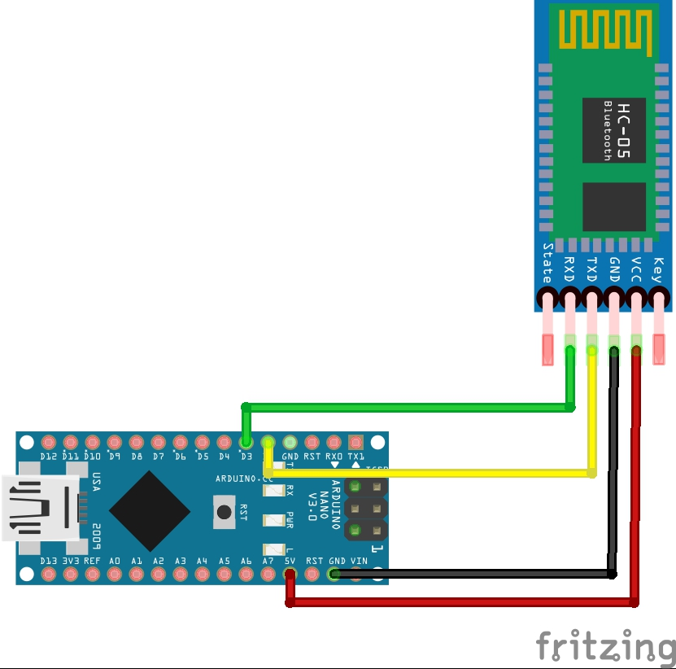
6
Circuit Diagram
Notes:
Here, we will transmit data from Smartphone via Bluetooth to the Arduino Uno and display it on Serial Monitor of PC.
Download and install a Bluetooth terminal application on your phone and use it to connect to the HC-05 Bluetooth module.
Data is sent from the Smartphone using the Bluetooth terminal application.

Slide 17
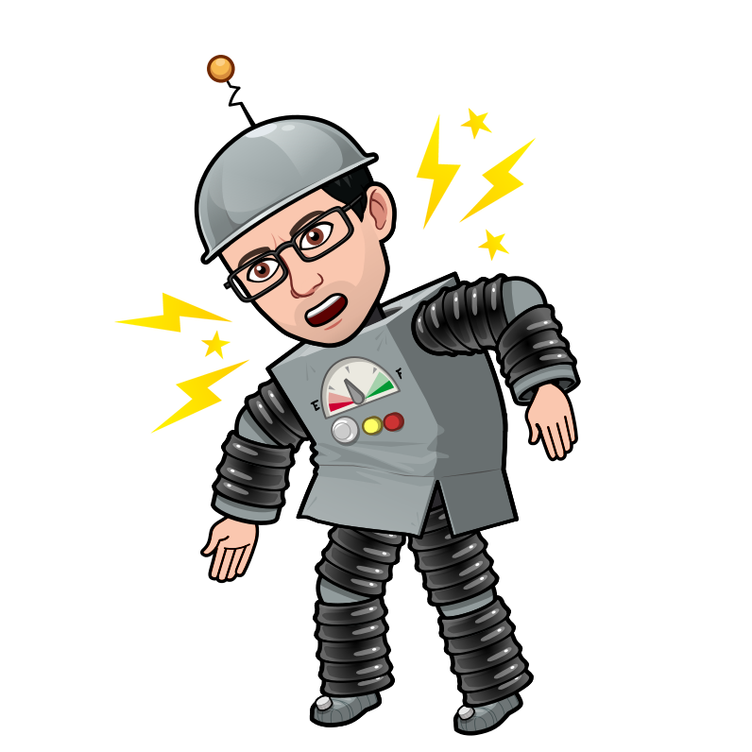
Connections
VCC -> 5V
GND -> GND
RXD -> D3
TXD -> D2

Slide 18
Project Ideas
Tap-Open Sensor:
Using an Arduino board and a HC-05 module, create a project that notifies the owner when their tap is open (by means of an audio/visual cue or even a mobile notification!).
Trash Full Sensor:
Create a project that notifies the owner when their trash can fills up, by means similar to the project above.
Automatic Door Closer:
Create a project that closes a door when the user instructs the Arduino to do so.

Slide 19
THANK YOU
Speakers
Satyam Shivam
Adway B

